Slide 1

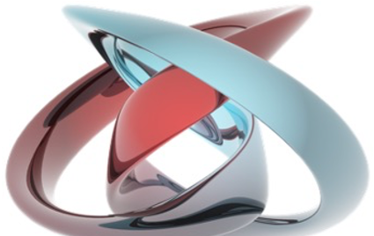
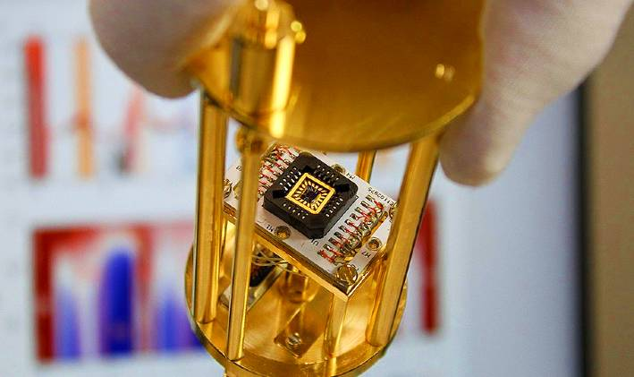
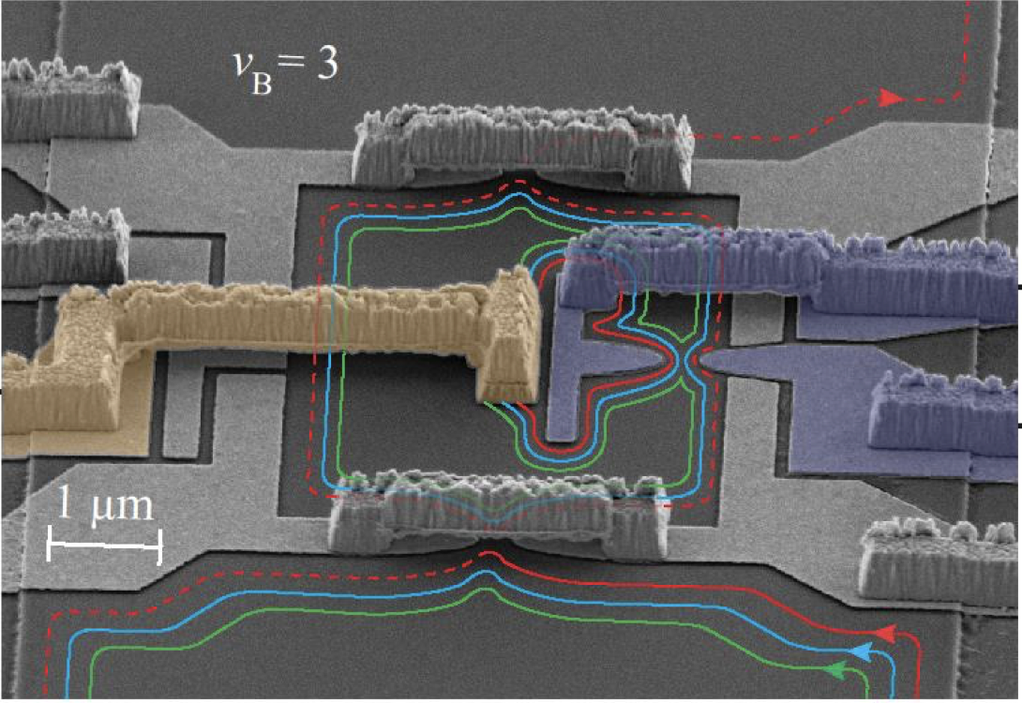
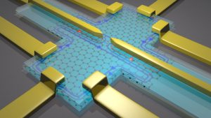
Laboratory of Quantum Physics: Topology and Correlations
Quantum transport in Mesoscopic systems
(PHYS-462)

Slide 2
Classical Hall effect
Ohm's law and Drude model (With external E and without B)
This equation is known as Ohm’s law: it tells us how the current flows in response to an electric field.

Slide 3
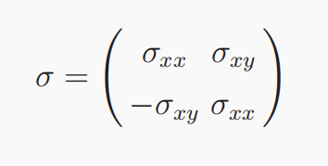
Classical Hall effect
Ohm's law and Drude model (With external E and without B)
This equation is known as Ohm’s law: it tells us how the current flows in response to
an electric field. The proportionality constant σ is the conductivity. The slight novelty
is that, in the presence of a magnetic field, σ is not a single number: it is a matrix. It
is sometimes called the conductivity tensor.

Slide 4
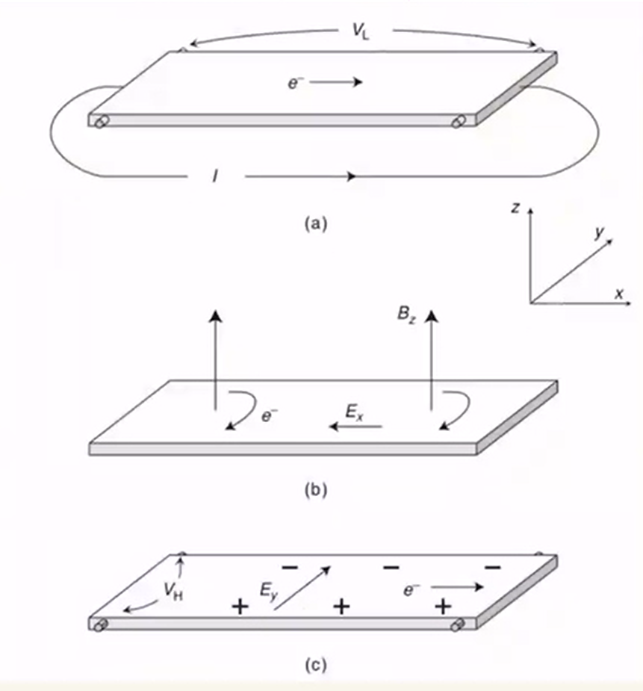
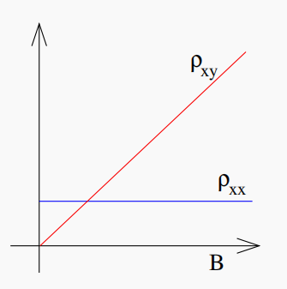
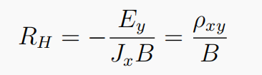
Classical Hall effect
Adding magnetic field, assuming B in the direction Z
τ in the friction term is called the scattering time. It can be thought of as the average time between collisions.
the Hall coefficient does not depend on the scattering time τ but depends only on microscopic information about the material: the charge and density of the conducting particles.

Slide 5
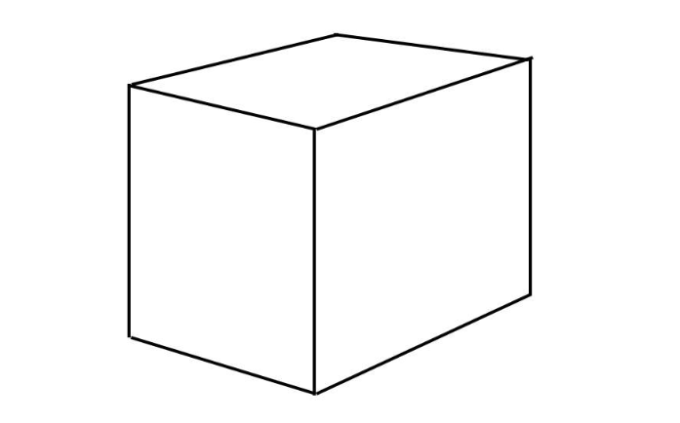
Classical Hall effect
Hall effect and Dimensions L
For classical resistivity and resistance,
R=ρL/L^{D-1}=ρL^{2-D}，for 2D, R=ρ!
resistance and resistivity have the same dimension
Scale independent
However, for cuboid, R=ρL/W
Geometric dependent!
L
L
L
L
For hall resistivity at any shape,
ρ_{xy}=E_{y}/j_{x},
R_{xy}=V_{y}/I_{x}=E_{y}*W/j_{x}*W=E_{y}/j_{x}=-ρ_{xy}，
for 2D,R=ρ!
Scale and Geometrc independent!
W
R=ρL/W
Conclusion: In two dimensions, resistance and resistivity have the same dimension, even hall resistance and Hall resistivity are the same thing.

Slide 6
Landau levels
The energy spectrum of three dimensional free electrons in a strong magnetic field and the degeneracy of the Landau energy level
Landau Gauge
When there is a magnetic field B, the Hamiltonian of the free electron is：
2
Where A is the vector potential, and B is equal to A. If the direction of the magnetic field is parallel to the Z direction, take the Landau gauge A= (-By, 0,0)

Slide 7
Landau levels
Landau Gauge
Because the Hamiltonian does not explicitly include x and z, we know from the translation invariance in the x and z directions that the momentum operators in both directions are commutative. Given the commutation of two Hermitian operators, such a state can be found to satisfy both of them simultaneously, that is, their common eigenstate can be obtained simultaneously. The corresponding total wave function can choose the eigenstates of P_{x} and P_{z}

Slide 8
Landau levels
Landau Gauge
Plug in the Schrodinger equation：H₀φ=Eφ

Slide 9
Landau levels
Landau Gauge
Therefore, according to the quantum theory, the motion of electrons in the x-y plane corresponds to the harmonic oscillator, the energy is quantized, and the energy spectrum of electrons moving along the z direction is continuous, so strict quantization phenomenon cannot be observed in this direction.

Slide 10
Landau levels
The Landau level degeneracy:
Two-dimensional system: L*L,
The density of state of the free electron gas is an energy-independent constant, ignoring the electron spin state, and this constant value is equal to (mL²/2πħ²).
Since the two-dimensional free electron gas has a continuous energy spectrum, E=ħ²k²/2m (k²=k_{x}²+k_{y}²)
Under the perpendicular magnetic field, it is aggregated into discrete Landau energy levels spaced ħω_{c,}(ω_{c}=eB/mc) apart. In such a process, the total number of quantum states does not change, so the Landau level is highly degenerate.
Degeneracy D =(mL²/2πħ²)* ħω_{c}=(mL²/2πħ²)* ħeB/mc=(eB/ħc)*L²

Slide 11
Landau levels
Electrons do simple harmonic motion in the x-y plane perpendicular to the magnetic field, which satisfies the above motion equation, where y₀ is the center of harmonic motion.
Known in the y direction, electron motion restricted, have values range:
0 < y₀= (ħc/eB) k_{x} < L,
k_{xmax} = eBL/ħc, known Δk_{x} = 2 π/L,
The degeneracy
D=k_{xmax}/Δk_{x}=(eBL/ħc)/(2 π/L)=(eB/ħc)*L²
Notice the magnetic flux through the system Φ=BL² and Magnetic flux quantum ϕ₀=hc/e,
D=Φ/ϕ₀
In other words, if only considering one Landau level, each Magnetic flux quantum corresponds to an energy eigenstate, that is, the state where the number of magnetic flux quantum is equal to the number of electrons.
The number of magnetic flux determines the degeneracy of the Landau energy.

Slide 12
Landau levels
Symetry Gauge
A_{x}=(-B/2)y, A_{y}=(B/2)y

Slide 13
Landau levels
Sysmetry Gauge
a⁺, a are the creation operator, annihilation operator and Landau level provides a good quantum number n
b, b⁺ is the angular momentum operator and provides a good quantum number m
angular momentum operator commutate with the creation operator, the annihilation operator, so it has the same eigenstate

Slide 14
Landau levels
Symmetry Gauge
Now let's solve for the wave function
Symmetry Gauge is much more important in FQHE and Bosonization, here, let's just start to get familiar with it and I would introduce it in Bosonization.

Slide 15
Landau levels
Points:
1. Each of the Landau levels has the same degeneracy, which is equal to the number of magnetic flux of the system.
2. So far, the discussion has not included electric fields, only magnetic fields, so there is no Hall effect.
In the absence of an electric field, there is no current in the system.
Although there is a plane wave in the x direction, there is no current in the x direction, because the current depends on the velocity, but the velocity of the electrons in the system is not proportional to the canonical momentum.
(The group velocity of a wave，v=dE/ħdk, in Landau levels, the energy is independent of k，therefore v=0）

Slide 16
Landau levels
Landau level interval ħω_{c} and degeneracy is proportional to the magnetic field strength B. So, in a strong magnetic field, the landau levels are spaced far apart, and each landau level can hold a lot of electrons. This is important for understanding the Quantum Hall effect.
In the above discussion, we ignored the electronic degrees of freedom, in fact, every landau level is divided into two spin up and spin down two energy levels, energy difference is the zeeman can μ_{B}gB. Due to zeeman is proportional to the magnetic field intensity, so under the strong magnetic field, we can omit the spin degree of freedom, here only consider a spin state.

Slide 17
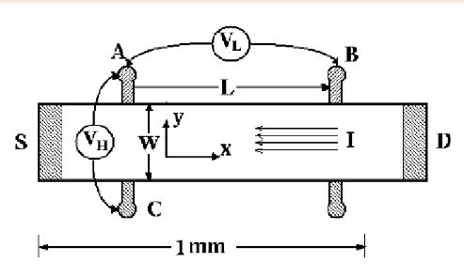
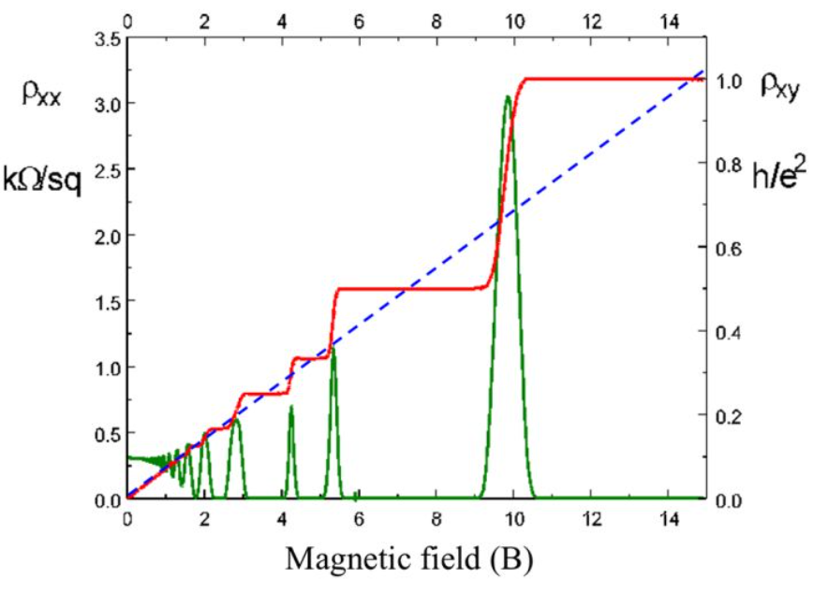
IQHE
Experimental verification of integer quantum Hall effect
K.von.Klitzing et al.,Phys. Rev. Lett. 45, 494 (1980) Add a magnetic field (15T) in the vertical direction of the Si-MOS N-inverse layer and an electric field in the parallel direction. By constantly changing the gate voltage (equal to changing the electron concentration), measure the hall current that the structure layer is perpendicular to the direction of the electric field and magnetic field

Slide 18
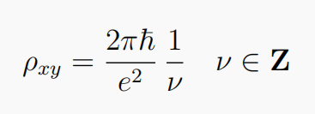
IQHE
Experimental verification of integer quantum Hall effect
the Hall resistivity ρxy sits on a plateau for a range of magnetic field, before jumping suddenly to the next plateau. On these plateau, the resistivity takes the value
The value of ν is measured to be an integer to an extraordinary accuracy — something like one part in 10⁹. The quantity ħ/e² is called the quantum of resistivity (with e, the electron charge). It is now used as the standard for measuring of resistivity. Moreover, the integer quantum Hall effect is now used as the basis for measuring the ratio of fundamental constants ħ/e²
sometimes referred to as the von Klitzing constant.

Slide 19
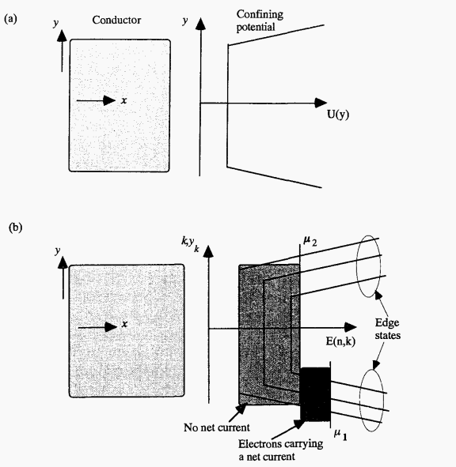
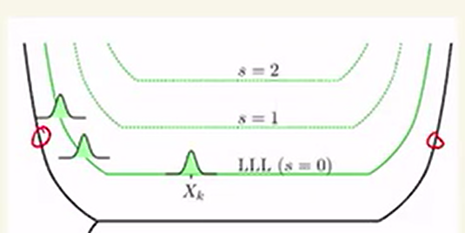
IQHE
Edge states
Consider an actual mesoscopic system in which the potential is constrained in the y direction, So the Landau energy level is still separated in bulk states and has a energy gap, whereas at the edges, the landau level will change, the edge state energy levels are continuous.

Slide 20
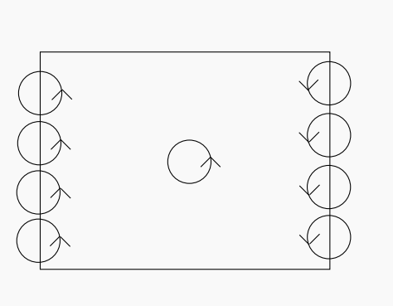
IQHE
Edge states
Two dimensional electron gas model+ strong magnetic field B+Actual mesoscopic devices:
（It's not free electrons moving in the magnetic field, so it's not the landau energy）
Simulation method: with a limited potential in transverse direction, two-dimensional electron gas can be simulated by a lattice model using a tightly bound model approximation, plus a strong magnetic field, write out the Hamiltonian, and calculate the state of the electron wave function at the center and edge of the device. Here, outside the edge is an infinite deep potential well, and the electron wave function is zero.
μ_{L}
μ_{R}

Slide 21
IQHE
Edge states
Electron Orbit：
1. Cyclotron orbit
The electrons have little kinetic energy and are limited by the magnetic field. If the center of the motion orbit of the electrons is in the center, the electrons will not collide with the wall, thus forming a cyclotron orbit. The motion is localized.
2. Skipping orbit（edge state）
Electrons collide with only one wall，the center of the oscillator is near the edge，under strong magnetic field, the cyclotron radius is smaller than the size of the device,The motion is expanded state。
3. back-forth orbit
Electrons collide with two walls, not considered here.
μ_{L}
μ_{R}

Slide 22
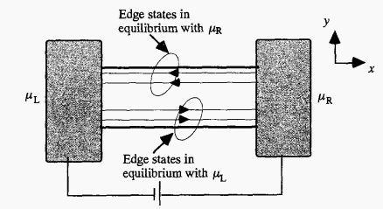

IQHE
Edge states
Skipping orbit（edge state）
1. On both sides of the device, and the drift velocity is opposite
2. The same edge channel is separated in space without overlapping.
On same side, a,b is no overlap，is the orthogonal state，Although the wave functions are partial overlap，but the spatial integral of the wave function，namely, the inner product is zero。
Different sides a, a’ has no overlap in space
a
b
b'
a'
μ_{L}
μ_{R}

Slide 23
IQHE
Edge states
Why only the edge state will conduct in the opposite direction?
1. From the perspective of the energy space in the upper panel, the middle energy level is flat, the velocity v=dE/ħdk=0, and only the electron velocity of the edge state is not zero
2. From a real space perspective, the electrons in the bulk spin around, so they're insulated, and only the edge states conduct electricity

Slide 24
IQHE
Edge states
1. With the addition of a magnetic field, the middle electrons spin around under the influence of lorentz magnetic force, unable to conduct current, while the edge electrons conduct forward, and the upper and lower electrons have opposite velocities（v=dE/ħdk）
2. The top edge electrons that are going from left to right are going to come from the left, which is the same chemical potential, and the bottom edge electrons that are going from right to left are going to come from the right, which is the same chemical potential

Slide 25

IQHE
Experimental verification of edge states
B
⊗
Experiment: GaAs-AlGaAs, adiabatic transport.
1987,G.Timp PRL59.732(1987)
The material is clipped into a ring, hollow in the middle, and the magnetic field is in full space, unlike the AB effect. The edge channel is formed, and the upper and lower channels do not overlap in space, but move in opposite directions.
The middle state is the edge state, which rotates automatically and does not overlap with other edge states.
W<Lcyclotron, AB effect, magnetoresistive oscillations，
W>Lcyclotron, no closed path, no AB effect, no magnetoresistive oscillation。
W
B
⊗
W

Slide 26
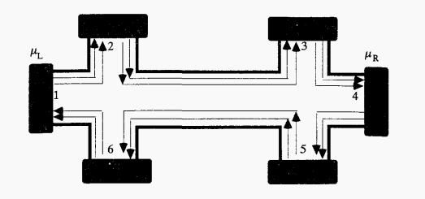
IQHE
Halperin theory and Application of the Buttiker formular
B.I.Halperin,PRB 25,2185(1982)
Multiterminal multichannel device，1, 2 is source and drain， both sides are electrodes contacts，In the middle is the device，Hall resistance can be obtained by measuring 3, 5 bias，The edge electrodes (2, 6) remain off-state when measuring hall current.
Under strong magnetic field，in the linear response case (weak bias), suppose a small bias is added at 1 (δμ), the chemical potential is different on both contacts and will generate a current. At edge states, the top current flows from left has same chemical potential μ_{L}and the bottom current is μ_{R}.
B⊗
E_{F}+δμ(μ_{L})
E_{F}(μR)

Slide 27
IQHE
Halperin theory and Application of the Buttiker formular
Start from Landauer formula, M channels,, Buttiker generalize it to multiple ports. Under strong magnetic field, spin degeneracy 2 could be ignored due to Zeeman energy split.

Slide 28
IQHE
Halperin theory and Application of the Buttiker formular
The actual transport is then explained using Buttiker Formular. Here M=2, only considering edge state(bulk state don't conduct current)
Here, Single channel transmittance is 1, and the total transmittance from terminal q to p is defined as:
T_{q→p}=TM=1*M=M
then, the conductance is:
G_{C}=I/ΔV=(e²/h)*2M
(e²/h) a single channel contribution

Slide 29
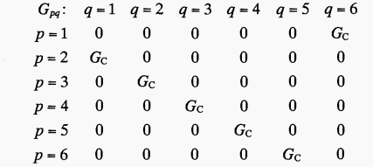
IQHE
Halperin theory and Application of the Buttiker formular
From,G_{C}=I/ΔV=(e²/h)*2M, we could get a conductance matrix:

Slide 30
IQHE
Halperin theory and Application of the Buttiker formular
Set V₄=0, The current at terminal P is equal to the corresponding conductance from q to p times the difference in voltage between the two terminals, sum over all the qs
V₄=0

Slide 31
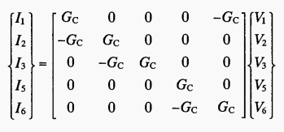
IQHE
Halperin theory and Application of the Buttiker formular
V₄=0

Slide 32
IQHE
Halperin theory and Application of the Buttiker formular
V₄=0
Set V₄=0, set 2,3,5,6 is the voltage port，hence I2=I3=I5=I6=0, then the hall resistance has quantized value：
V₂=V₃=V₁,V₅=V₆=0, I₁=G_{C}V₁
R_{L}=(V₂-V₃)/=(V₅-V₆)/=0,
R_{H}=(V₂-V₆)/=(V₃-V5)/=V₁/I₁=1/G_{C}=(h/e²)(1/2M)
Quantized,filling factor,N=2M landau levelnumber

Slide 33
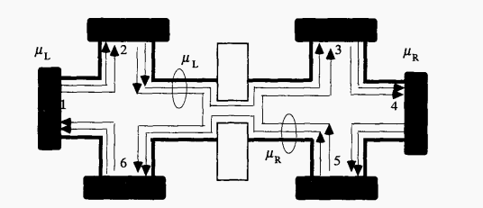
IQHE
Halperin theory and Application of the Buttiker formular
Next considering the effect of back scattering：The edge states will not all propagate from left to right, and there will be some backscattering. N edge states can propagate from left to right and total edge channelstate is M.
Setting μ_{L}=eV₁ and μ_{R}=0➬μ₂=eV₁ and μ₅=0
Nμ_{L}
(M-N)μ_{L}
Quantum point contact

Slide 34
IQHE
Halperin theory and Application of the Buttiker formular
R_{L}：
Backscattering leads to longitudinal resistance
R_{H}:
Hall resistance remian quantized!
Reason:
Backscattering has occurred to lead 2, 6 voltage difference decreases and the current from the left to right is decreases，hence the ratio is invariant！
Nμ_{L}
(M-N)μ_{L}
Quantum point contact

Slide 35
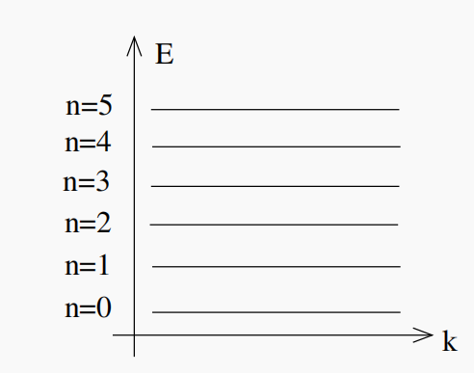
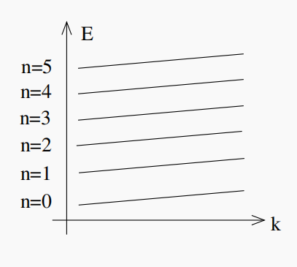
IQHE
IHQE vs 1D Landauer conductancee
V(x)
E
2
x
k
V(x)
E
x
k

Slide 36
IQHE
E
k
k_{FL}
k_{FR}
When Fermi energy is selected at different locations, different amounts of Landau energy levels will be occupied, that is, different amounts of landau energy levels will contribute. Therefore, several landau energy levels will be occupied, so an integer needs to be added, G_{H}=ν(e²/h), which ν is the filling factor.

Slide 37
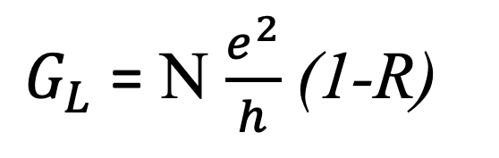
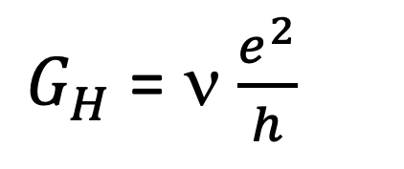
IQHE
E
k
k_{FL}
k_{FR}
$G_{H}$ = ν $\frac{e^{2}}{h}$
$G_{L}$ = Ν $\frac{e^{2}}{h}$ (1-R)

Slide 38
IQHE
A few notes:
1. Although IQHE is in 2D，yet the dispersion relation is one-dimensional，because we're only thinking about the limiting potential in this direction. It's mathematically the same as the Landauer Channel, therefore, the derivation of the Hall conductance for the quantum Hall effect is the same as that conductance for a one-dimensional uniform wire without impurities.
2. One key point, adding impurities, the one-dimensional Landauer conductance formula needs to be modified, that is, the transmission of impurities needs to be considered(1-R). In quantum Hall effect, the edge state electrons are spatially isolated, and the left and right wave functions have no spatial overlap in space, so there is no need to modify. Therefore, this is why quantum Hall current does not dissipate, because there is no scattering.

Slide 39
Landau levels
Sysmetric Gauge
A_{x}=(-B/2)y,A_{y}=(B/2)y

Slide 40

Landau levels
Now let's solve for the wave function
The single-particle states are especially simple in the lowest Landau level (n = 0),
The eigenstate |0, m> has its weight located at the circle of radius r=(2m)^{1/2}l

Slide 41
Magnetic Canonical invariance
Canonical invariance of an ideal two-dimensional system in a magnetic field
Although the choice of A is not unique, B does not change with the gauge chosen by A.
A different, wavefunction different, but engine value is invariant

Slide 42
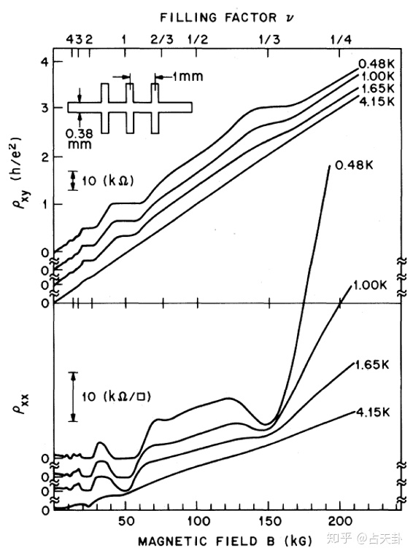
FQHE (1982)

Slide 43
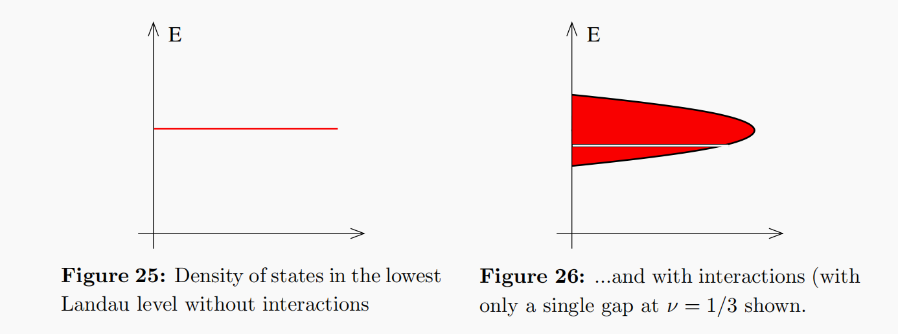
FQHE
The coulomb interaction of electrons must be considered in order to obtain a fraction plateau.
Electron electron interactions can be viewed as perturbations, and the high degeneracy of the Landau level can be split into a series of discrete energy levels with tiny band gaps between them. If the whole Landau level is completely filled, it can contribute 1 conductance.
The figure on the left corresponds to a fully filled Landau energy level with no interaction. The figure on the right corresponds to the interaction condition in which the Landau energy opens a tiny band gap in the 1/3 filled position. When Fermi energy is located in the band gap, a part of landau energy level is filled, thus the fractional plateau appears.

Slide 44
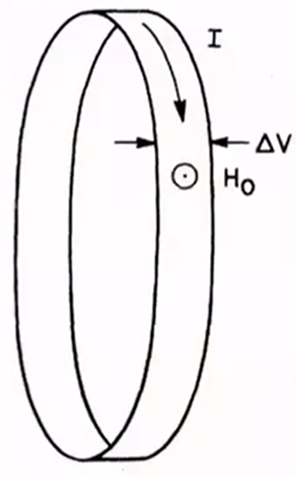
FQHE
Laughlin argument
ΔV, y
Longitudinal
vector potential A
Landau gauge:
Φ
Φ→I (longitudinal current)
→under H_{0,}the k is changed
→Wave packet along in transverse direction shifts
Transverse

Slide 45
Laughlin States
The Lowest Landau Level
Let’s now construct the wavefunctions in the symmetric gauge(angular momentum conservation). We’re going to focus attention on the lowest Landau level, n = 0, since this will be of primary interest when we come to discuss the fractional quantum Hall effect. The states in the lowest Landau level are annihilated by a, meaning a|0, m>=0, The trick is to convert this into a
differential equation. The lowering operator is
We introduce z = x-iy and ¯z = x + iy and introduce the corresponding holomorphic and anti-holomorphic derivatives

Slide 46
Laughlin States
The Lowest Landau Level
Then, a and a⁺ takes the simple form, l_{B} is magnetic length:
The lowest Landau level wavefunctions ψ_{LLL}(z, z¯) are then those which are annihilated by this differential operator, f(z) is any holomorphic function.

Slide 47
Laughlin States
The Lowest Landau Level
We can construct the specific states |0, m> in the lowest Landau level by similarly. writing b and b⁺ as differential operators.:
The lowest state ψ_{LLL,m=0} is annihilated by both a and b. There is a unique such state given by
We can now construct the higher states by acting with b⁺. Each time we do this, we pull down a factor of z/l_{B}. This gives us a basis of lowest Landau level wavefunctions in terms of holomorphic monomials

Slide 48
Laughlin States
The Laughlin Wavefunction
The first approach to the fractional quantum Hall effect was due to Laughlin, who described the physics at filling fractions v=1/m, with m an odd integer。So, considering two particles interacting in the lowest Landau level, We take an arbitrary central potential between them,
By using the conservation of angular momentum. In quantum physics, this means that we work with eigenstates of angular momentum. if we want to talk about angular momentum in Landau levels, we should work in symmetric gauge. The single particle wavefunctions in the lowest Landau level take the form

Slide 49
Laughlin States
The Laughlin Wavefunction
These states are localised on a ring of radius r = (2m)^{1/2}l_{B}. The exponent m of these wavefunctions labels the angular momentum. This can be seen by acting with the angular momentum operator
As long as we neglect mixing between Landau levels (which is valid if ħω_{B} > V ) then the two-particle eigenstates for any potential must take the form

Slide 50
Laughlin States
The Laughlin Wavefunction of two particles
where M, m are non-negative integers, with M determining the angular momentum of the centre of mass, and m the relative angular momentum. Note that here, and below, we’ve made no attempt to normalize the wavefunctions.
we can just write down eigenfunctions for a complicated potential V (r) without having to solve the Schrodinger equation. It’s even more surprising that all potentials V (r) have the same energy eigenstates.

Slide 51
Laughlin States
For N > 2 particles. Nonetheless, on general grounds, any lowest Landau level wavefunction must take the form for some analytic function f(z).
Moreover, this function must be anti-symmetric under exchange of any two particle z_{i} ↔ z_{j}, reflecting the fact that the underlying electrons are fermions. Laughlin’s proposal for the ground state wavefunction at filling fraction ν = 1/m is:
It has the standard Jastrow form, with pairwise correlations (apart from the gaussian factor); as a result, its probability distribution can be interpreted as the Boltzmann weight of a two-dimensional one component plasma, which allows a derivation of many of its properties. Anti-symmetry requires that m be an odd integer, making this wave function applicable to ν = 1/3, 1/5, etc., but not to other fractions.

Slide 52
Laughlin States
Clearly this is anti-symmetric when m is an odd integer.
The first product guarantees that no two electrons can occupy the same place in space; they must be separated from each other by some distance;
The second product guarantees that none of the electrons will be drawn too far from the origin by the positive background charge. The pre-factor vanishes with a zero of order m whenever two electrons come together. Meanwhile, the exponential factor decreases quickly whenever the electrons get too far away from the origin. The wavefunction is peaked on configurations that balance these two effects.
focus on what the wavefunction is telling us about a single particle, say z₁. The terms that depend on z₁ in the pre-factor of the Laughlin wavefunction are

Slide 53
FQHE
Filling factor in Laughlin States
For an infinite system, the filling factor is defined as:
ν=n/n_{ϕ}
n is two dimensional electron density, n_{ϕ} is the magnetic flux density, the unit is magnetic flux quantum ϕ₀= hc/e.
When the system size is limited, the filling factor is changed to:
ν=N/N_{ϕ}
N is the total number of electrons in the system，N_{ϕ} is the total number of flux quantum ，definition：
N_{ϕ}=(magnetic field B)*(System area A)/ϕ₀
N_{ϕ}It also represents the number of electron states in the lowest Landau level or the dimension of a single electron Hilbert space

Slide 54
FQHE
which tells us that there are m(N-1) powers of z₁.
This, in turn, tells us that the maximum angular momentum of the first particle is m(N-1) and so its maximum radius is
R ≈ (m(N-1))^{1/2}l_{B}
Correspondingly, the area of the droplet is
A ≈πR² ≈ 2πmNl²_{B} (where we’ve replaced N-1 with N).
Recall that the number of states in the full Landau level is
AB/Φ0 = A/2πl²_{B} ≈ mN.
This argument gives us the filling fraction:
ν=N_{ϕ}=(magnetic field B)*(System area A)/ϕ₀=N/mN=1/m

Slide 55
Plasma Analogy
Laughlin wavefunctions are very easy to write down. But it’s hard to actually compute
The reason is simple: they are wavefunctions for a macroscopic number of particles which means that if we want to compute expectation values of operators, we’re going to have to do a macroscopic number of integrals ∫d²z_{i} and that’s difficult.
For example, suppose that we want to figure out the average density of the quantum Hall droplet.
We need to compute the expectation value of the density operator:

Slide 56
Plasma Analogy
We’ll now show that this is the potential energy for a plasma of N charged particles moving in two-dimensions, where each particle carried electric charge q = -m.

Slide 57
Plasma Analogy
The key observation is that the expectation value has the same formal structure as the kind of things we compute in classical statistical mechanics, with the denominator interpreted as the partition function:
Indeed, we can make this analogy sharper by writing the probability distribution，so it looks like a Boltzmann distribution function,β — which, in a statistical mechanics context is interpreted as inverse temperature — to take the specific value：β=2/m

Slide 58
Plasma Analogy
Note that Poisson equation in two dimensions says that the electrostatic potential generated by a point charge q is:
The first term is the Coulomb potential between two particles of charge q when both the particle and the electric field lines are restricted to lie in a 2D plane. Namely, the potential energy between two particles of charge q is then U = qϕ, which is indeed the first term.

Slide 59
Plasma Analogy
The second term describes a neutralising background of constant charge. A constant background of charge density ρ₀ would have electrostatic potential obeying −∇²ϕ = 2πρ₀. Meanwhile, the second term in the potential obey
which tells us that each electron feels a background charge density:ρ₀= -1/(2πl²_{B}).
Note that this is equal (up to fundamental constants) to the background flux B in the quantum Hall sample.

Slide 60
Plasma Analogy
Now we can use our intuition about this plasma. To minimise the energy, the plasma will want to neutralise, on average, the background charge density ρ_{0,} Electroneutral condition. Each particle carries charge q = -m which means that the compensating density of particles n should be mn = ρ_{0.} The plasma analogy tells us that the average density of plasma is :
This is the expected density of a state at filling fraction ν = 1/m.

